Slide 1

Maneuver detection Hackathon ISAE-SUPAERO
NGUYEN Théo

Slide 2
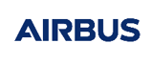
Presentation - Automatic maneuver detection
Introduction and Background

Slide 3
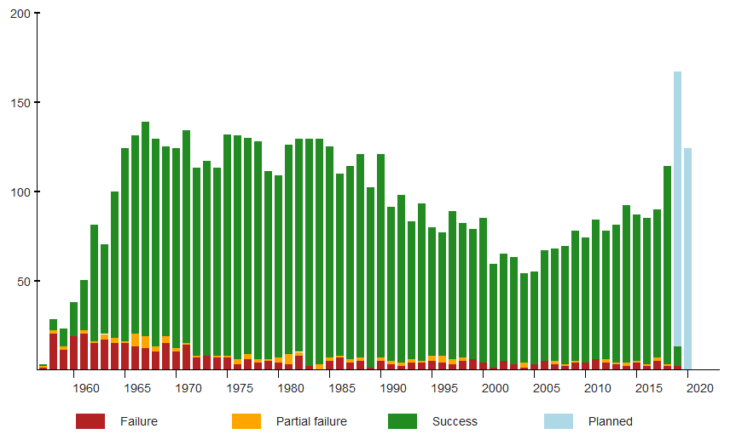
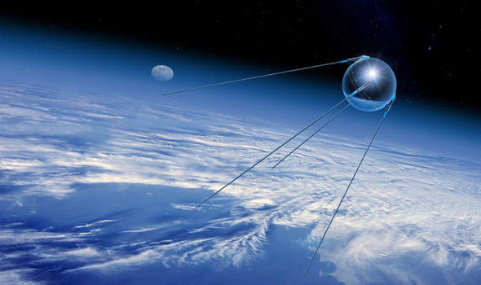
Introduction to space debris: history
1957: launch of Sputnik (first Russian satellite)
1958: launch of Explorer 1 (first satellite from the USA)
1964: launch of Syncom 2 (first geostationary satellite)
1971: 1000th satellite launched
2014: 5000th satellite launched
2020: 6000th satellite launched
2021/2022: 10000th satellite launched
Source: Wikipedia
Source: express.co.uk

Slide 4
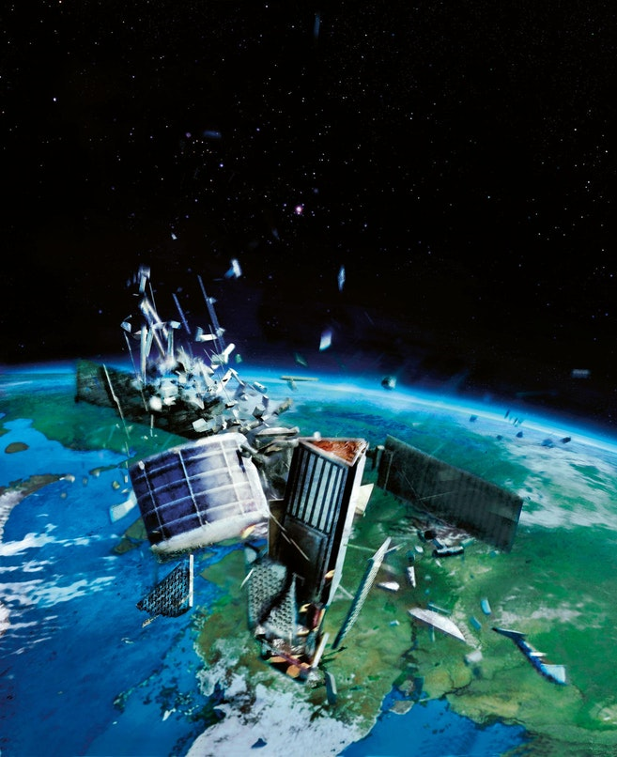
Space debris: collision
“Space is wide”
Could be used as an argument to neglect the risk of collision
Not wide enough in 2009…
2009 collision between Iridium-33 & Kosmos-2251:
Happened on February 10, 2009
Iridium-33 was operated
No avoidance manoeuvre was planned
Relative speed: 42 000 km/h
Entire destruction of both satellites
Consequences:
~ 1000 pieces of debris generated (radius > 10cm)
Many other smaller pieces
New laws created for mandatory disposal of defunct satellites (LEO & GEO)
Video collision
Source: Cosmos Magazine

Slide 5
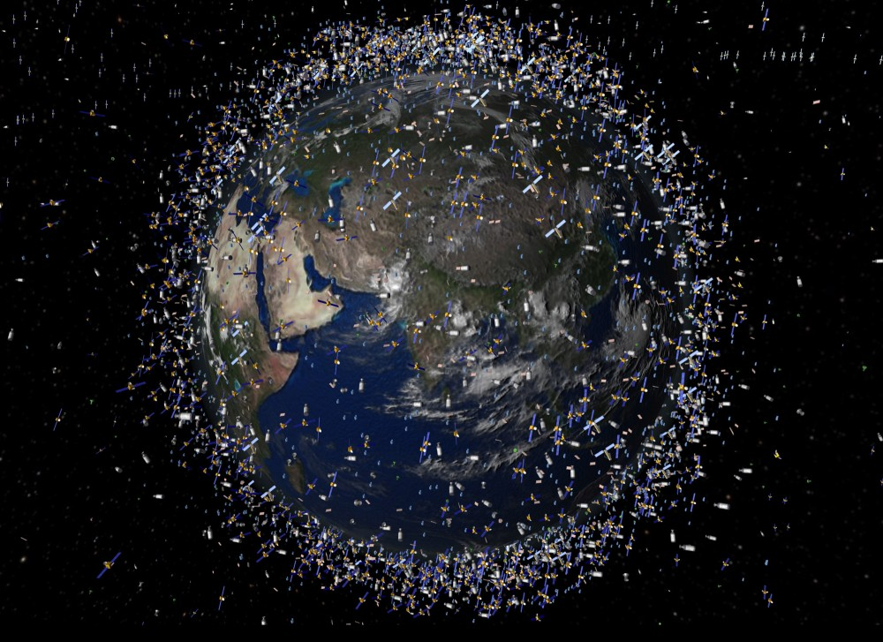
Presentation - Automatic maneuver detection
Introduction
Space Surveillance Awareness (SSA) is an increasingly important domain since the number of satellites in space is exponential. Maneuver detection is one of the problematics
Improving the robustness and the automation of the orbit determination
Improving collision avoidance algorithms
Artist view of space population
( source http://theglobserver.com/wp-content/uploads/2013/01/dc3a9bris-spatiaux-e1429698057747.jpg)
(1) source: https://www.esa.int/Safety_Security/Space_Debris/Space_debris_by_the_numbers

Slide 6
Presentation - Automatic maneuver detection
Data simulation

Slide 7
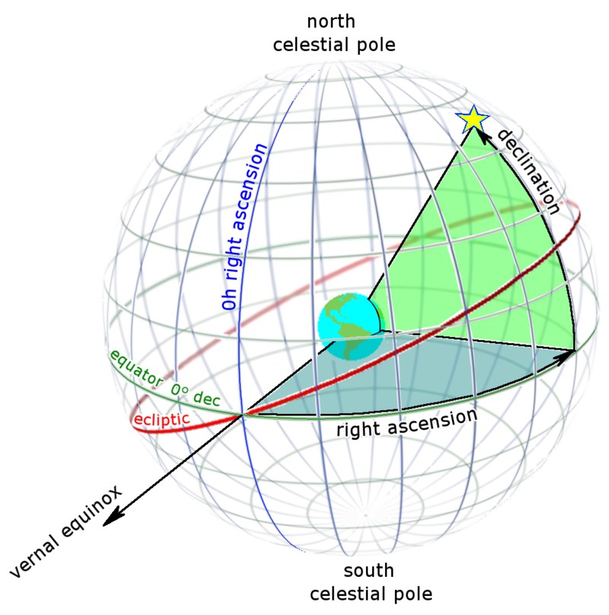
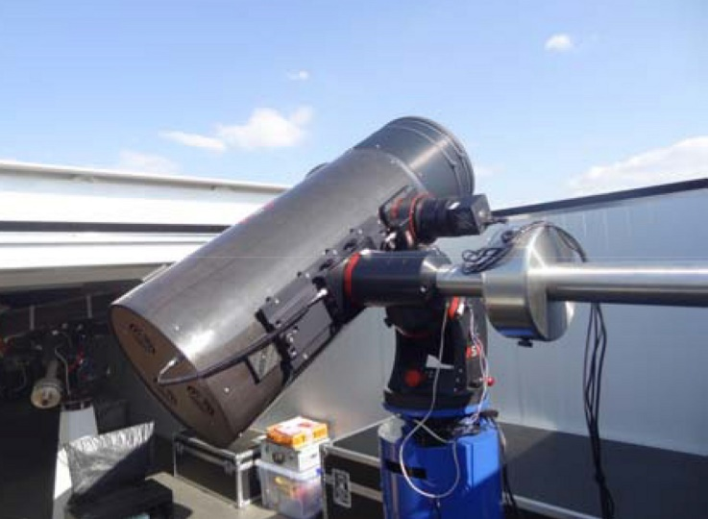
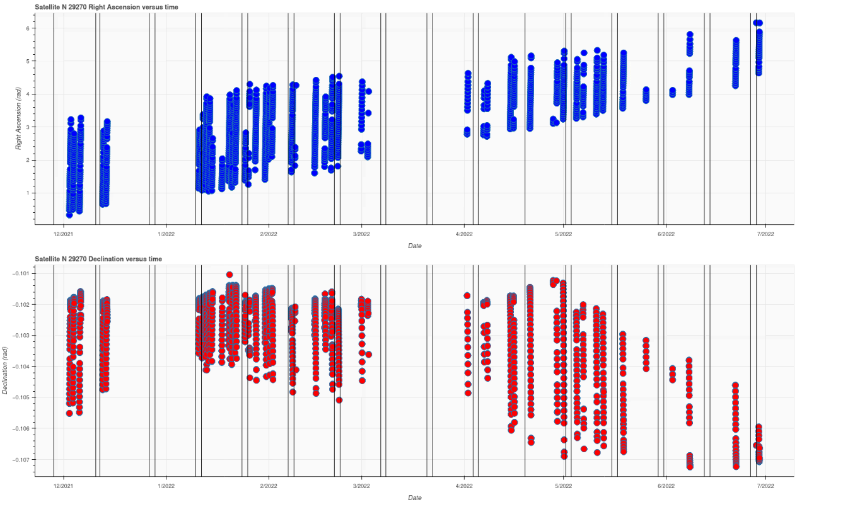
Campaigns on real data
Airbus Robotic Telescope (ART) observed three EUTELSAT satellites (HB8, HB9 & HB10) for 6 months.
This telescope provides 2 types of measurements (Right Ascension and Declination)
Compared to the previous study, there are large gap between measurement sessions and the measurements are unevenly spaced.
There are abnormal values due to tracks correlation errors.
Right Ascension/Declination coordinates
(source: wikipedia)
Airbus Robotic Telescope (ART)
Right Ascension / Declination of HB8 satellite over 6 months.
Each vertical stroke is a maneuver.

Slide 8
Presentation - Automatic maneuver detection
Problem definition
Noise on measurements
uncorrelated gaussian noise on Right Ascension/Declination
Noise on initial guess of the orbit
uncorrelated gaussian noise on the keplerian parameters
Estimated with the test residuals, thanks to Eutelsat Orbits
Order of magnitude of the minimum deltaV 0,02 m/s
Worse Case Scenario
 | Bias | Standard Deviation
RA [arcsec] | 0.06 | 0.38
DEC [arcsec] | -0.011 | 0.44
True trajectory
Propagated trajectory from last orbit determination
Noisy measurements
Maneuver
Visibility period from the ground
(source: Théo Nguyen)
Residuals = Simulated measurements from estimated trajectory - Noisy observed measurements

Slide 9
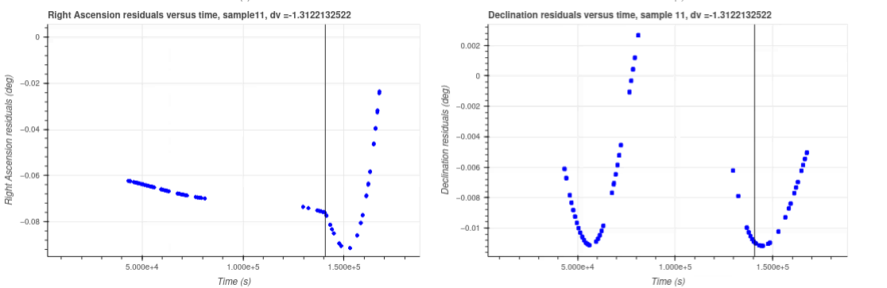
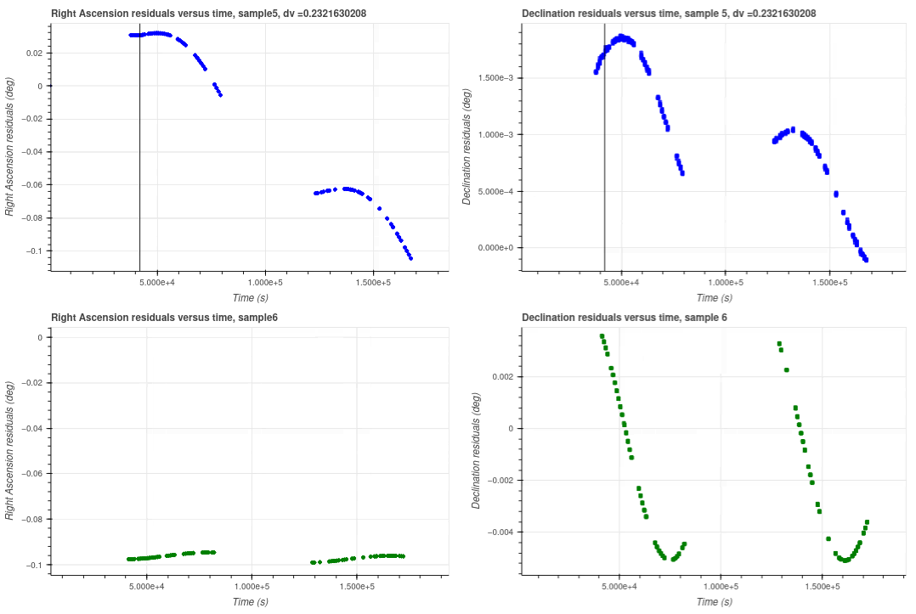
Residuals
After a maneuver, the residuals are impacted and a typical pattern is often visible.
However, depending on the orbit determination errors, residuals can be large event without any maneuver. Therefore detection can be difficult.
Right Ascension / Declination residuals
with maneuver
Right Ascension / Declination residuals
without maneuver

Slide 10
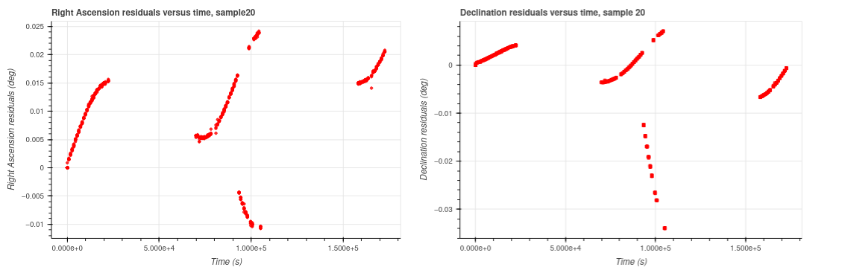
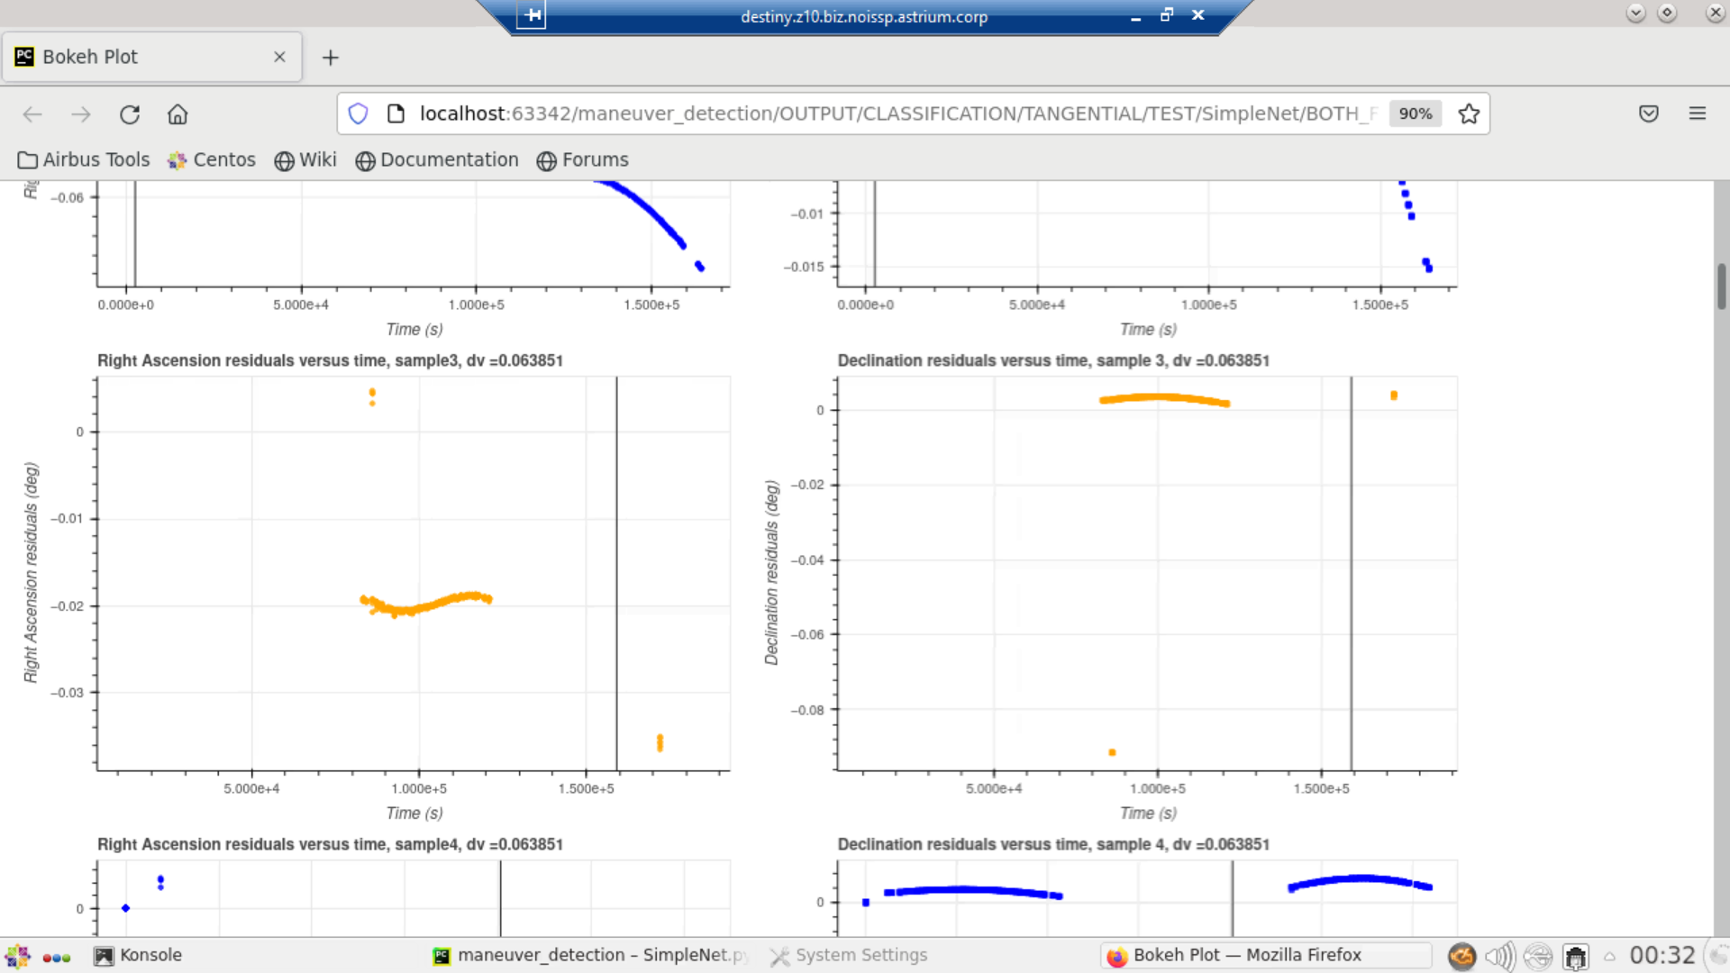
Test dataset samples
Residuals of false positive sample
Residuals of false negative sample

Slide 11
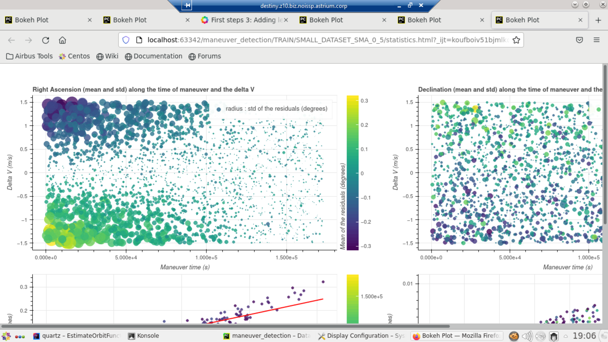
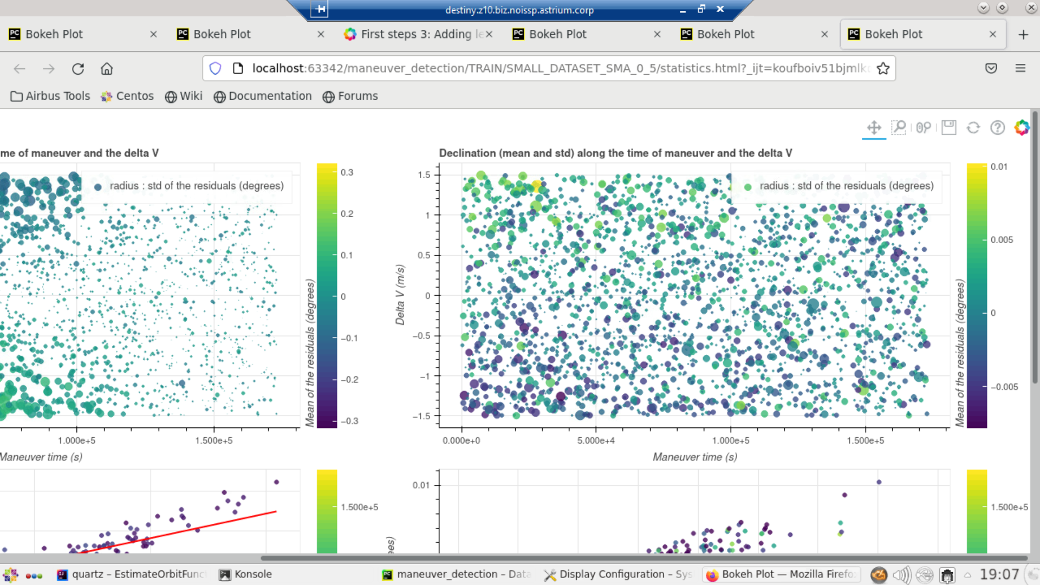
Dataset Analysis
Small Δv and late maneuvers have a small standard deviation and no offset . They will be difficult to detect.
Simple threshold detection algorithms will be inefficient.
Mean and standard deviation of the training samples with tangential maneuvers along the time and the ∆v of the maneuver

Slide 12
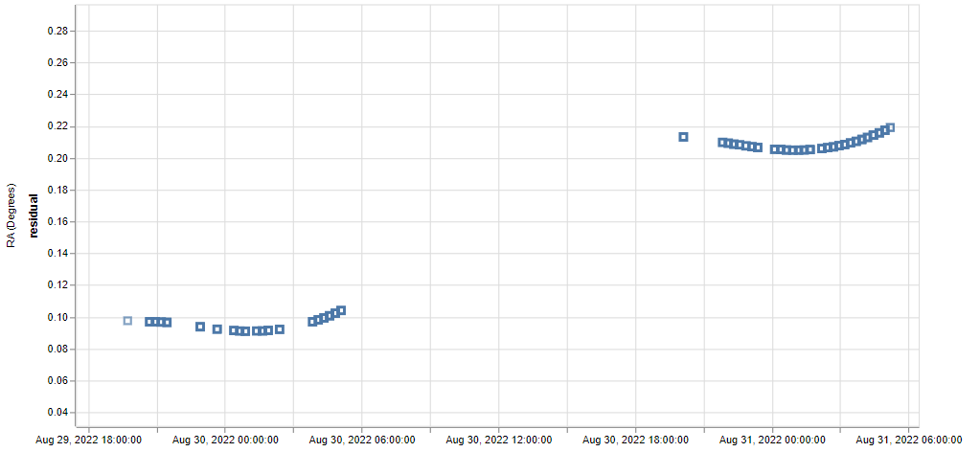
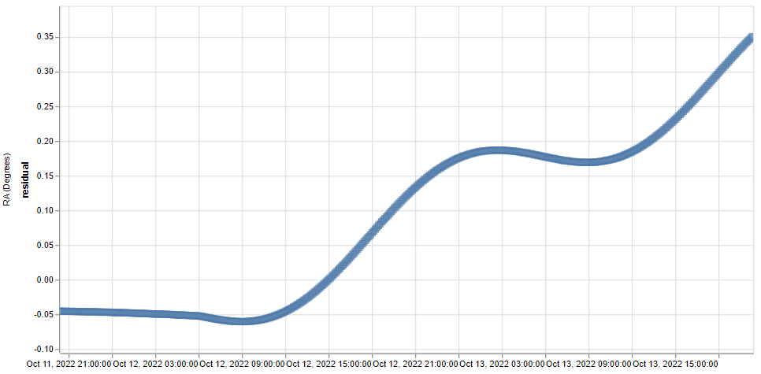
Datasets
Size :
ML
(70000 samples)
M
(39740 samples)
TRAIN3
Real Observations
TRAIN1
TRAIN2
TRAIN3
Evenly spaced
TRAIN1
TRAIN2

Slide 13
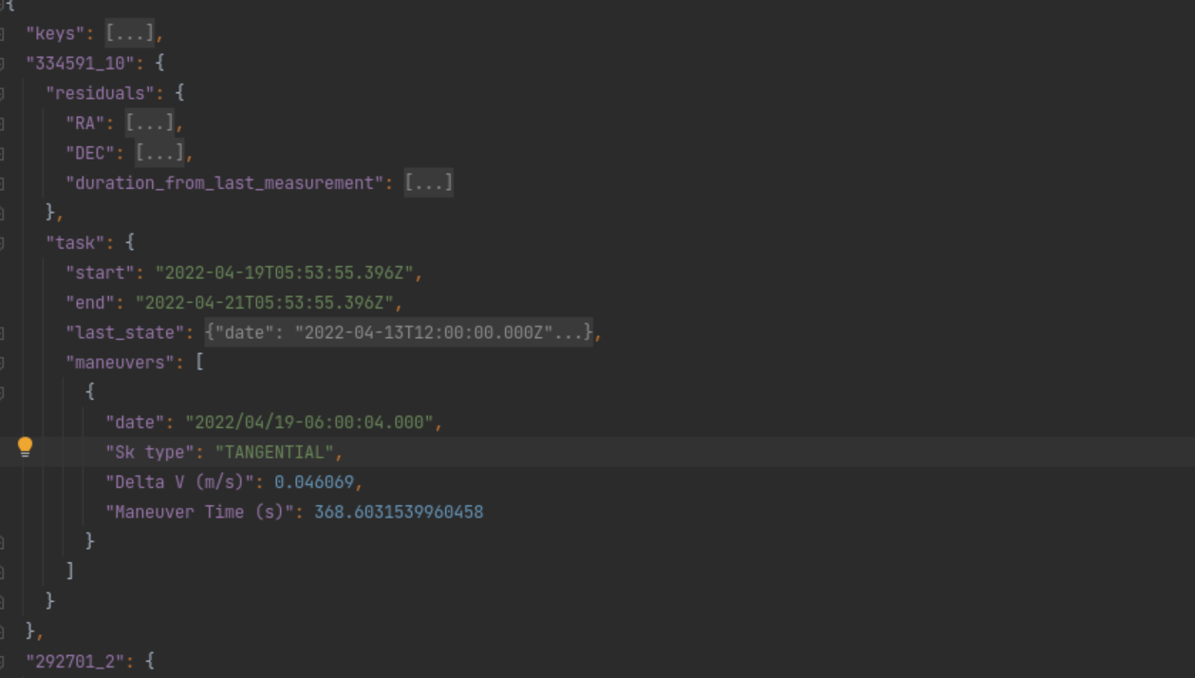
Dataset Structure

Slide 14
Scoring
Detection of the maneuver
Estimation of the delta V
Estimation of the date of the maneuver
F1 Score
MAE
MAE
Final Score

Slide 15
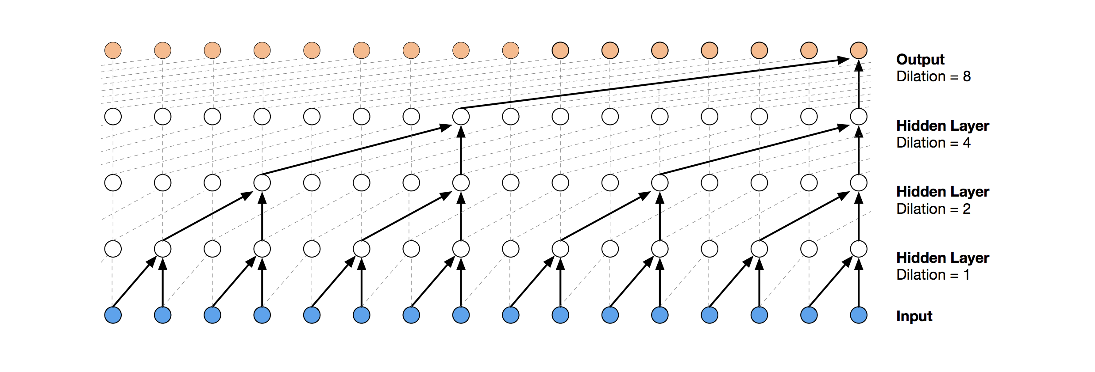
Which solution ?
Simple Neural Network
Spectral Analysis
Temporal Convolutional Network +anomaly detection
Time Serie Prediction + anomaly detection
Interpolation (Aurto-encoders? )
RNN /LSTM/GRU
Moving anomaly detection
Filter the test data
Feel free to combine !!
Schema of a temporal convolutional neural network

Slide 16
Presentation - Automatic maneuver detection
Organization

Slide 17
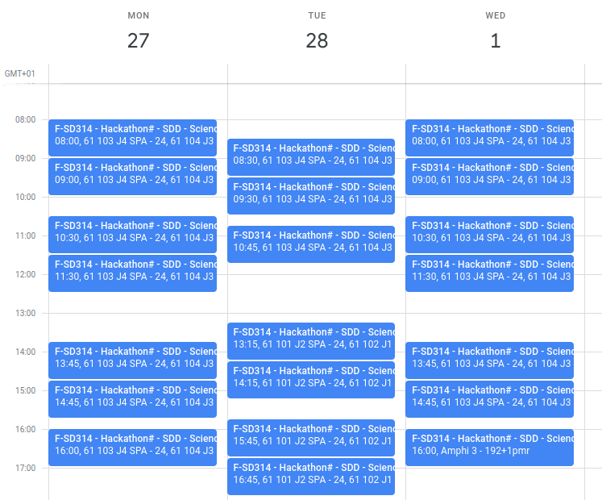
Hack when?
Monday 8h30 :
Coffee and breakfast
Kickoff presentation
Tuesday 12h :
61.101, 61.102
Board games
Wednesday 15h:
Amphi 3
Wrap-up presentation, winners announcement
Day schedules depend on subject, check with organizer

Slide 18

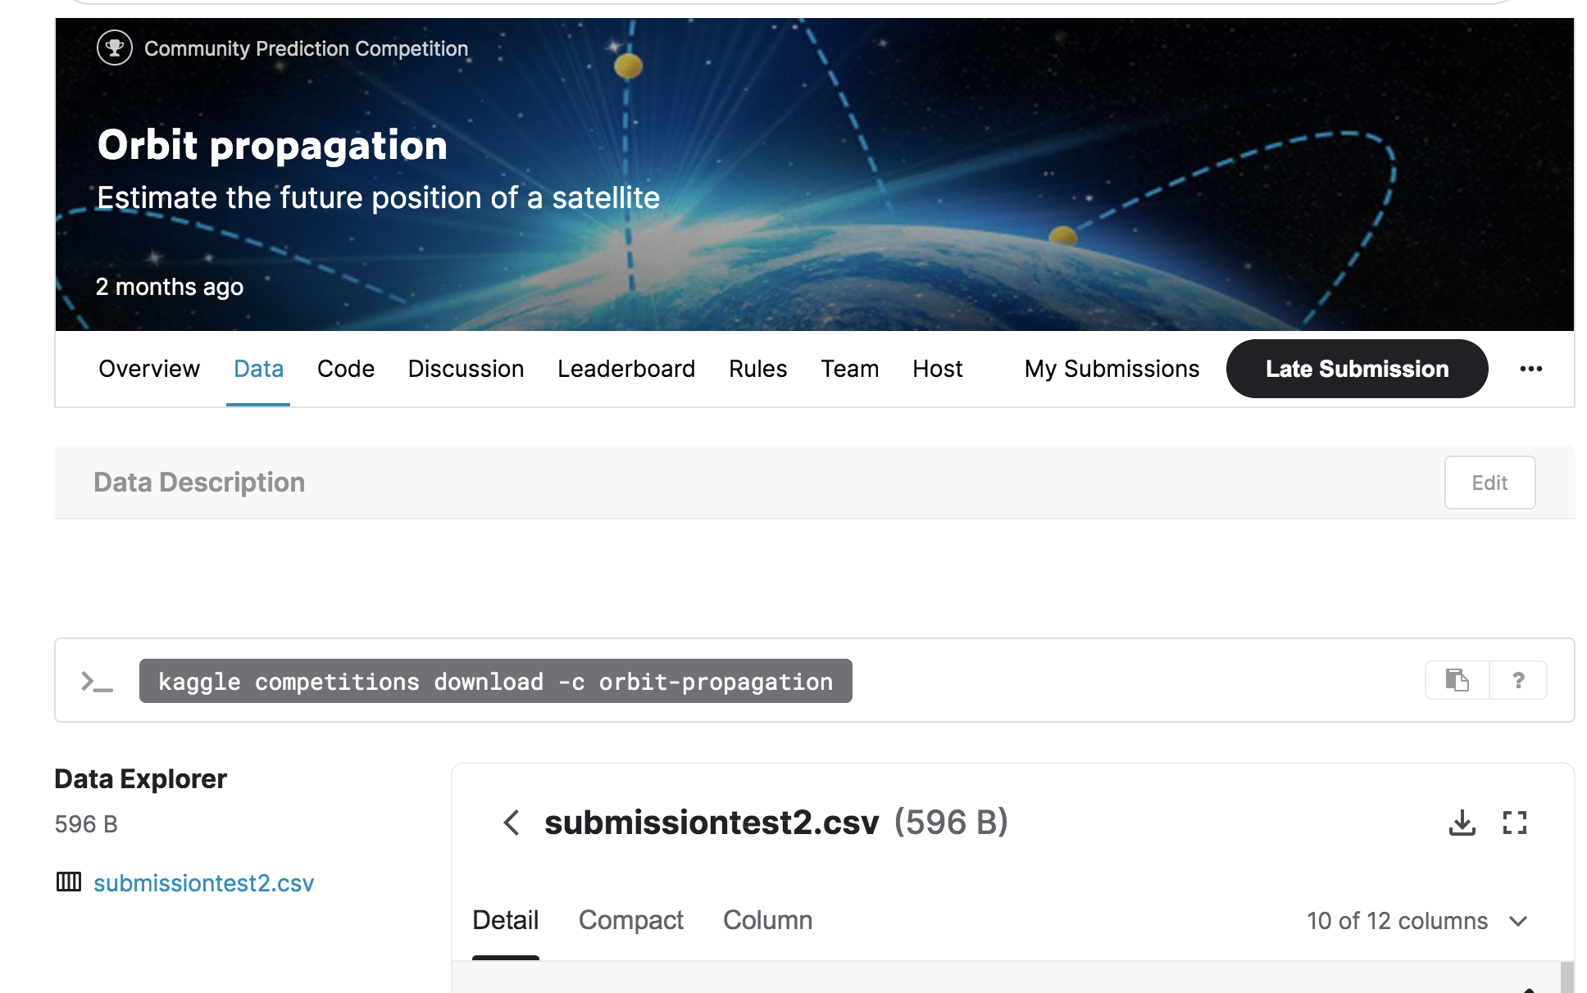
Organisation du hackaton
Preparation
Team Work
LeaderBoard
Visualization
Generator
Custom metrics
Json
Training dataset
Submission
example
50%
Live Score
Dataset Parser
?
Submission
Generator
Csv submission
SPLIT
Json
Test dataset
Final Evaluation
50%
Json
Test Solutions
For the organizer only
Available for the team

Slide 19


Good luck !!
Tips:
Keep networks simple
Visualize your results
Organize the roles in your team
Have fun, may the best win !

Slide 20
Thank you
Copyright mention

